Slide 1
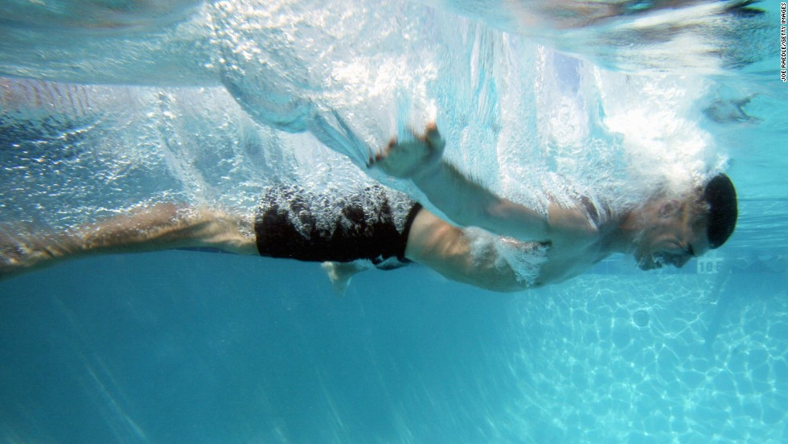
Why does this hurt?

Slide 2
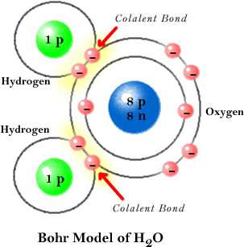
Water = H₂O
Oxygen and Hydrogen are bonded together by Covalent Bonds
O and H share some electrons

Slide 3
Water is a Polar Molecule
Oxygen atom is bigger than Hydrogen atoms. Oxygen has 8 protons – it pulls the electrons close and becomes a little negative
POLAR: it has 2 ends, like the poles
- a negative end (O)
- a positive end (H)
It is called the Mickey Mouse Molecule

Slide 4
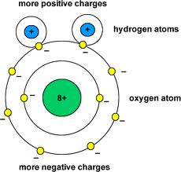
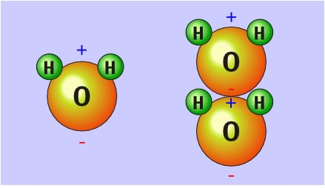
O is “stronger” and pulls most of the electrons toward it.
Oxygen side of the molecule becomes slightly negative – and the H side of the molecule becomes a slightly positive +
This unequal sharing of electrons makes the water molecule POLAR (have 2 ends = like the poles)
- a positive end and a negative end

Slide 5
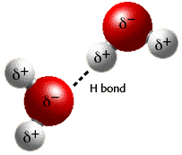
How does water stick together?
The positive end of one water molecule attracts the negative end of another water molecule, until all the water molecules are connected.
The “connections” between different water molecules are called Hydrogen Bonds.
OPPOSITES ATTRACT!!

Slide 6
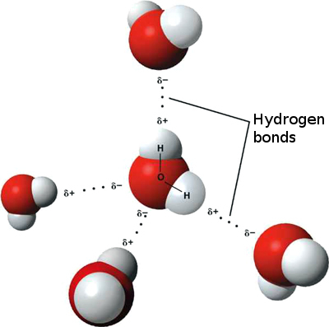
What is a Hydrogen Bond?
A weak attraction between the slightly negative oxygen of one molecule, and the slightly positive hydrogen of another
H-Bonds are weak

Slide 7
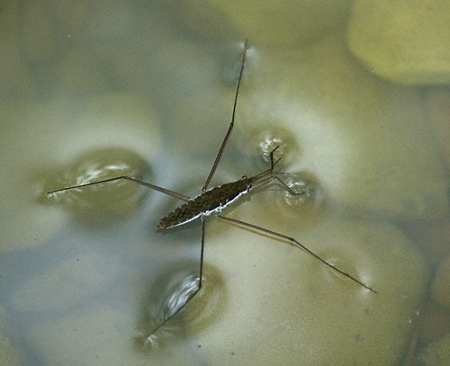
Cohesion
Cohesion: attraction between molecules of the
same substance. Water likes Water.
Water is cohesive because the H-bonds hold the molecules together. Cohesion of water molecule creates high surface tension.
A paper clip can float in water and insects can walk on water because the H-bonds hold the water molecules together
Water strider

Slide 8
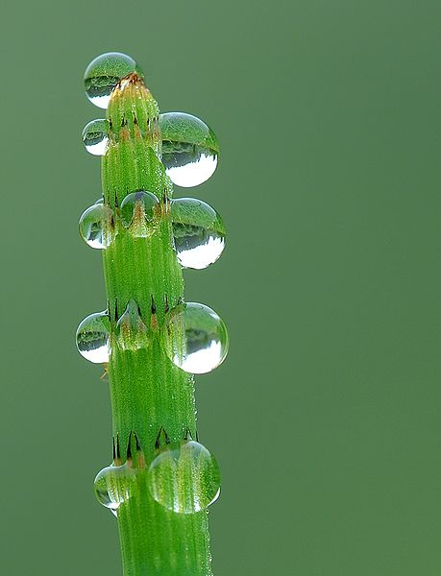
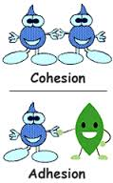
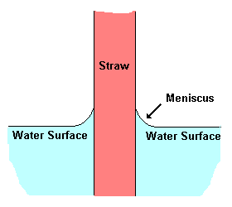
Adhesion
Adhesion: attraction between molecules of different substances. Water loves other substances.
Examples:
Meniscus in graduated cylinder: water sticks to the glass and “crawls up”
Water sticking to the leaf of a plant

Slide 9
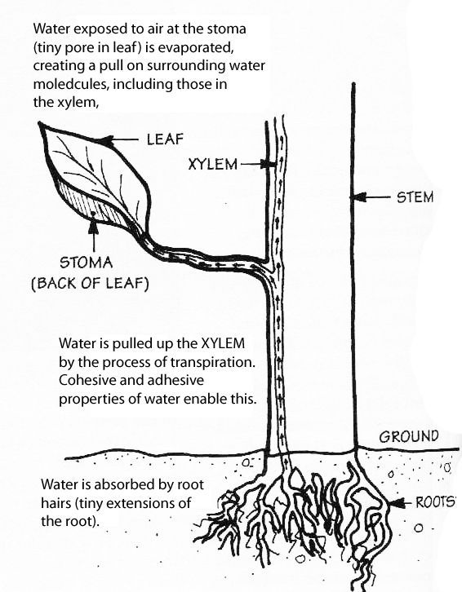
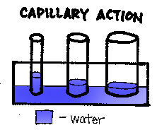
Capillary action: water moves up thin tubes
Water moves up in plants
from the roots to the leaves
though tubes called xylem.
The thinner the tube, the higher
the water moves.

Slide 10
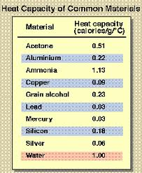
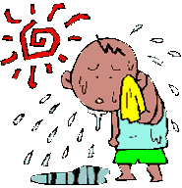
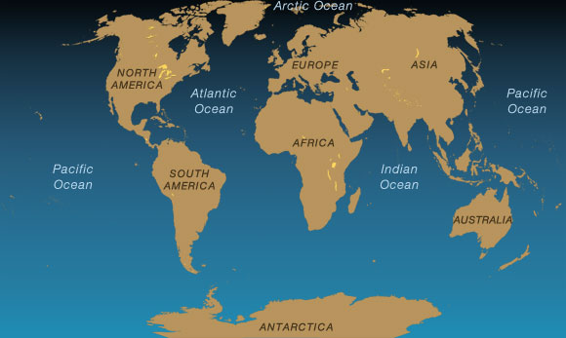
Heat Capacity
Water has a HIGH heat capacity! It takes a lot of heat energy to raise the temperature of water!
Water absorbs the heat produced by cell processes and regulates the temperature of the cell
The lakes and oceans on Earth help to stabilize temperatures because so much heat is absorbed by water

Slide 11
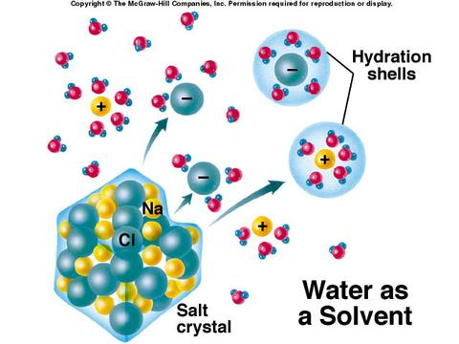
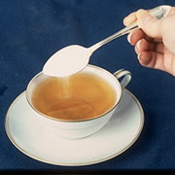
Universal Solvent
Water dissolves most substances!
Water inside the cells and body can carry
nutrients and waste around.
Like dissolves like!!

Slide 12
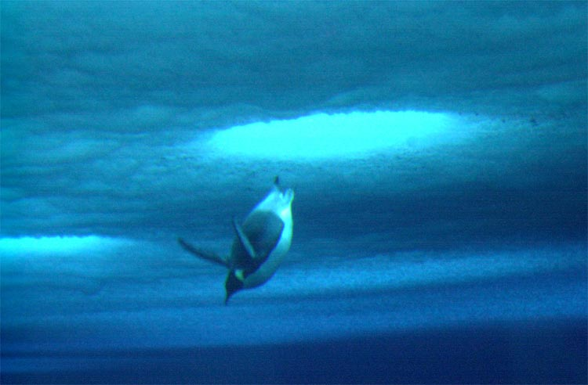
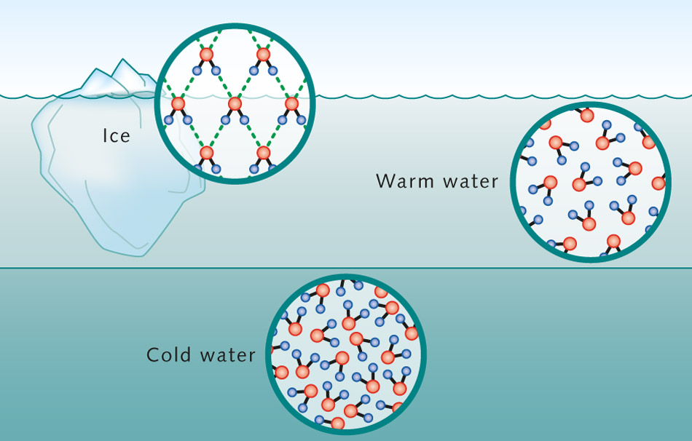
ICE IS LESS DENSE THAN LIQUID WATER
Solid water (ice) is less dense than liquid water and floats.
Water expands when it freezes - Ice floats.
Floating ice prevents rivers, lakes, and oceans from freezing solid.
The top ice insulates the water below from the extreme cold.

Slide 13
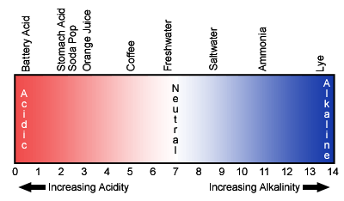
pH: 0 -14
pH: A measure of a solution’s acidity or alkalinity (basic)
pH scale: 0-14
0 = Very Acid 14= Very Basic
Pure Water is neutral.
0-6 ACID 7 NEUTAL 8-14 Base

Slide 14
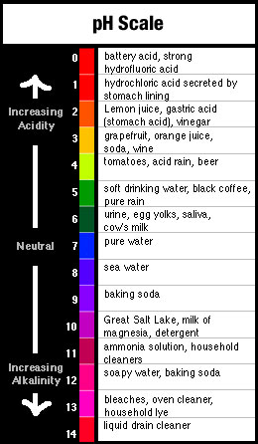
Based on a scale of 10
An acid with a pH of 1 is 10 times more acidic than a substance with a pH of 2
A base with a pH of 12 is 10 times more basic than a substance with a pH of 11

Slide 15
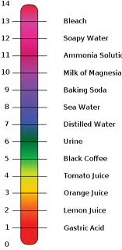
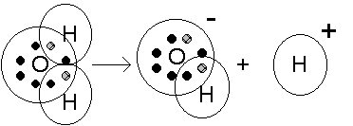
pH Scale
Acids are substances that have
a higher H+ ion than 0H-
concentration.
Bases are substances that have
a higher OH- ion than H+
concentration.

